Slide 1


Hugo Gomez
3/17/2023

Slide 2

Outline
Executive Summary
Introduction
Methodology
Results
Conclusion
Appendix

Slide 3
Executive Summary
We want to predict if the flacon 9 first stage will land successfully
If we can predict that a falcon 9 launch will be successful SpaceX will be able to reuse the launch and hence save money
This same information can be used to aid another company that would like to rival SpaceX launches economically
Summary of all results
Found that there is a difference in success rate of landing based on location of launch
Some launch sites had higher success rates than others based on the payload
While Orbits like ES-L1, GEO, HEO, SSO, VLEO had higher end of the spectrum success rate ratio then other orbits
Orbit vs Flight number was not a linear relationship in the success rate of launches

Slide 4
Introduction
Goal is to determine the cost of a launch
using the SpaceX’s Flacon 9 launch information on Wikipedia
To accomplish this goal, it is important that we first parse the information using Web Scraping, data wrangling and formatting, and requests to the SpaceX API
After parsing the data in a way that we can use Exploratory Data Analysis and Visualization to grab data that would be used for machine learning predictions
Folium is then used to display the different environment/locations where launches take place which help finding the most optimal location for a launch to take place
A dashboard is created using Plotly Dash to be able to present the data in an interactive application where filtering and other features are available

Slide 5

Section 1

Slide 6
Methodology
Executive Summary
Data collection methodology:
Request to the SpaceX API & Clean the Requested Data
Perform data wrangling
Extract Falcon 9 launch record HTML table from Wikipedia
Parse the table and convert it to pandas data frame
Perform exploratory data analysis (EDA) using visualization and SQL
Perform interactive visual analytics using Folium and Plotly Dash
Perform predictive analysis using classification models
Find best Hyperparameter for SVM, Classification Trees and Logistic Regression

Slide 7
Data Collection
Using Data Wrangling and formatting we are able to gain access to important data that would give us insight to predicting the success of a launch
We request and parse the SpaceX launch data using the GET request to only include Falcon 9 launch information
It is important to fill the missing data with that of the mean of the column data to get the most accurate results possible
Data wrangling on the dataframe to get the most accurate information for future uses

Slide 8
Data Collection – SpaceX API
1. REQUEST
Request to the SpaceX API
Normalize the returned json content to convert to Pandas dataframe
Obtain rocket, payload, launchpad, and many other useful information using API
Store this data into lists to create readable dataframe
Filter Falcon 9 launches only
Data wrangle to remove missing values
Github Link - SpaceX API
2. Convert to Pandas Dataframe
3. Filter to only include Falcon 9 Launches
4. Data Wrangling
5. Save to .csv file

Slide 9
Data Collection - Scraping
1. Request data
Using HTTP GET method to request the Falcon9 Launch HTML page, as an HTTP response
Create Beautiful Soup Object
Extract all important information
Parse HTML tables into dataframe
Github Link - Scraping
2. Extract all column/variable names from HTML table header
3. Parse HTML tables
4. Create data frame
5. Save to .csv file

Slide 10
Data Wrangling
Goal is to remove any missing values in order to ensure that the data is accurate
Determine the proper data labels that would be used for training supervised models
Calculate the number of launches on each site
Calculate the number and occurrence of each orbit
Calculate the number and occurrence of mission outcome per orbit
Create a landing outcome label from Outcome column
Github Link - Data Wrangling

Slide 11
EDA with Data Visualization
Visualize the relationship between Flight Number and Launch Site with a scatter point chart
Visualize the relationship between Payload and Launch Site with a scatter point chart
Visualize the relationship between success rate of each orbit type with a bar chart
Visualized the relationship between Flight Number and Orbit type with a scatter point chart
Visualize the relationship between Payload and Orbit type
Visualize the launch success yearly trend with a line chart
Github Link - EDA with Data Visualization

Slide 12
EDA with SQL
Display the names of the unique launch sites in the space mission
Display 5 records where launch sites begin with the string 'CCA'
Display the total payload mass carried by boosters launched by NASA (CRS)
Display average payload mass carried by booster version F9 v1.1
List the date when the first successful landing outcome in ground pad was achieved.
List the names of the boosters which have success in drone ship and have payload mass greater than 4000 but less than 6000
List the total number of successful and failure mission outcomes
List the names of the booster_versions which have carried the maximum payload mass
List the records which will display the month names, failure landing_outcomes in drone ship ,booster versions, launch_site for the months in year 2015.
Rank the count of successful landing_outcomes between the date 04-06-2010 and 20-03-2017 in descending order.
Github Link - EDA with SQL

Slide 13
Build an Interactive Map with Folium
Mark all launch sites on a map
Mark the success/failed launches for each site on the map
Calculate the distances between a launch site to its proximities
All of these geographical patterns contribute to finding the most optimal launching site
Github Link - Interactive Map with Folium

Slide 14
Build a Dashboard with Plotly Dash
Add a Launch Site Drop-down Input Component
Allow use to select from multiple launch sites
Add a callback function to render success-pie-chart based on selected site dropdown
Enable the dashboard to change to the pie chart to the currently selected launch site
Add a Range Slider to Select Payload
Include a range of payload to view the scatter plot at the selected range
Add a callback function to render the success-payload-scatter-chart scatter plot
Attach the range slider to function properly with the success-payload-scatter-chart scatter plot
Github Link - Dashboard with Plotly Dash

Slide 15
Predictive Analysis (Classification)
1. Load the dataframe
Create a column for the class
Standardize the data
Split into training and test data
Use the different predictive models to test and then compare their results
Github Link - Predict Analysis (Classification)
2. Standardize data
3. Split the data into training and test data
4. Apply all predictive models to test
5. Compare and evaluate results

Slide 16
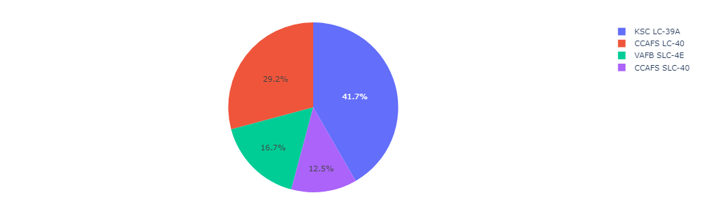
Results
Exploratory data analysis results
We see that different launch sites have different success rates. CCAFS LC-40, has a success rate of 60 %, while KSC LC-39A and VAFB SLC 4E has a success rate of 77%. s
Now if you observe Payload Vs. Launch Site scatter point chart you will find for the VAFB-SLC launchsite there are no rockets launched for heavypayload mass(greater than 10000).
Predictive analysis results
From the different models used for predictions of launches the most accurate was the Decision Tree with 88% accuracy compared to the others which had 83% accuracy with the given parameters

Slide 17

Section 2

Slide 18
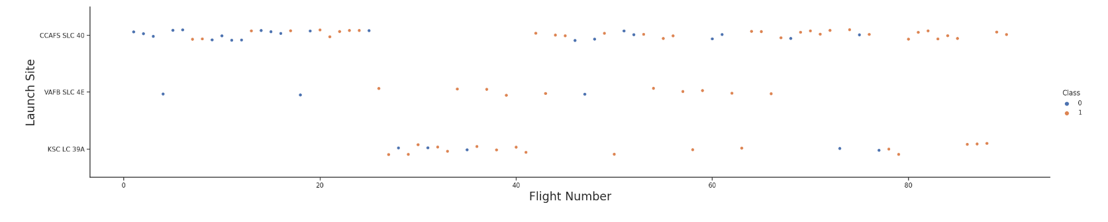
Flight Number vs. Launch Site
This is a scatter plot of Flight Number vs. Launch Site
From this screenshot we know that from the increasing number of flights there is an increase in the number of successful launches on the first stage which would influence SpaceX to do more launches

Slide 19
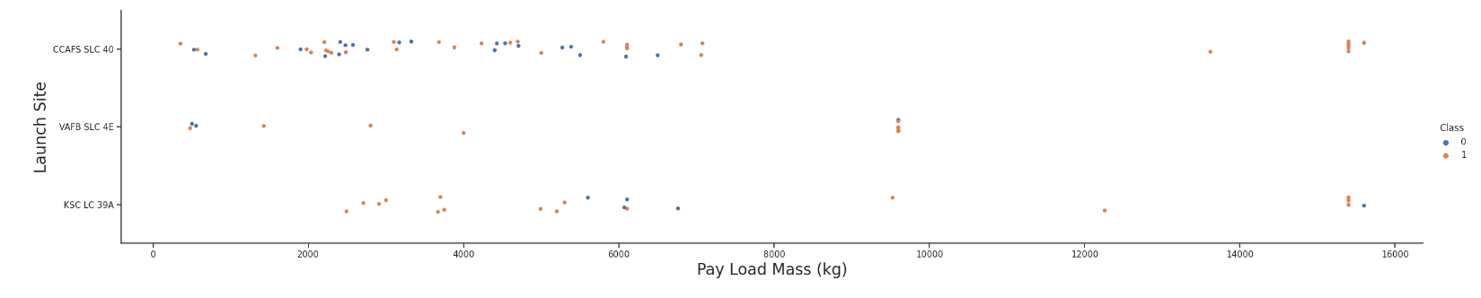
Payload vs. Launch Site
Scatter plot of Payload vs. Launch Site
The CCAFS SLC 40 launch site as well as the KSC LC 39A both reached max payload mass with a high success rate
CCAFS SLC 40 Launch site experienced most all of its failure before the 80,000 pay load mass mark
VAFB SLC 4E did not have many launches in general in comparison with the other two sites

Slide 20
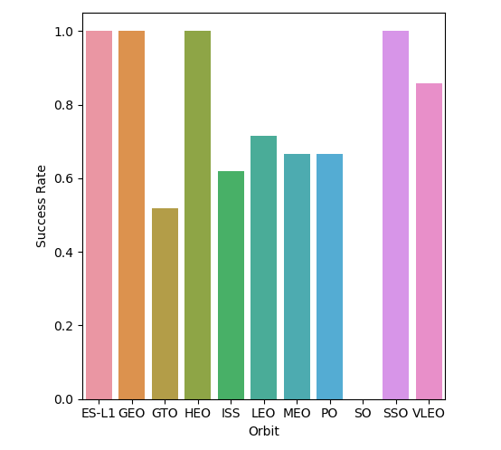
Success Rate vs. Orbit Type
In the plot to the right, we can see that Orbits like Sun-synchronous orbit have a 0% success rate
While Orbits like ES-L1, GEO, HEO, SSO, VLEO have all above 80% success rate with launches

Slide 21
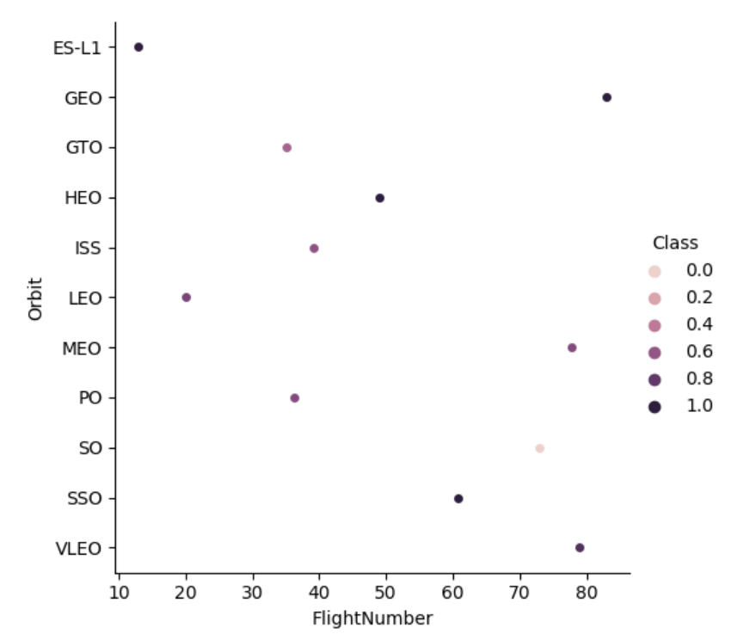
Flight Number vs. Orbit Type
In this graph we also notice that orbits with higher flights does not guarantee high success but that the orbits plays a role in success rate
ES-L1 with the lowest flight number has a high success rate due to orbit playing a role in success rate

Slide 22
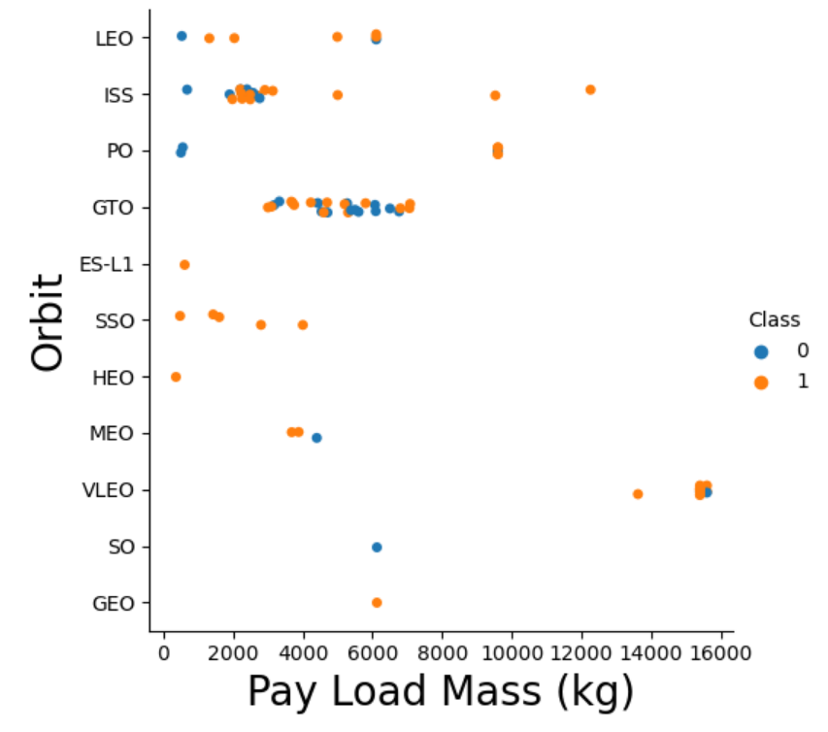
Payload vs. Orbit Type
In the plot we notice that regarding pay load mass and success rate ES-L1, SSO, HLEO have high success rates
Other orbits like GTO and ISS are not necessarily at a high success rate of launches
Note that most launches are done with less than 80,000 pay load mass

Slide 23
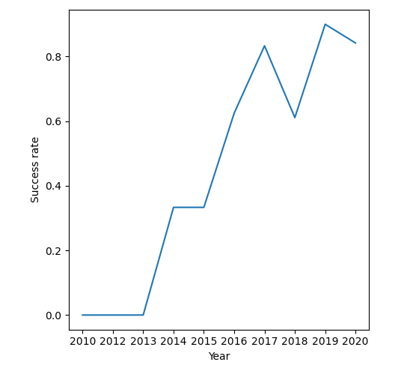
Launch Success Yearly Trend
There is a great increase of launching success rate over the years
This plot is telling of SpaceX ability to adapt and improve on their launches which in the long run will be more economically efficient

Slide 24
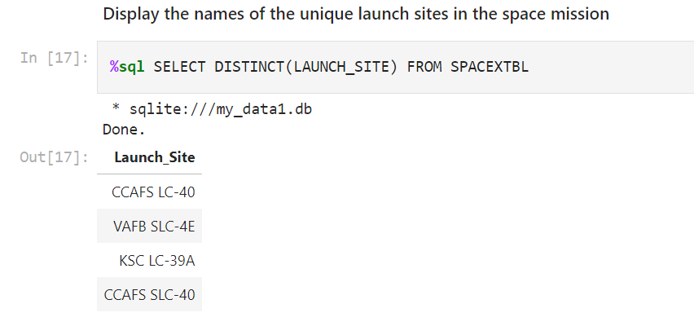
All Launch Site Names
Using DISTINCT function and Launch_site as the column in the SPACEXTBL we can obtain the unique launch sites

Slide 25
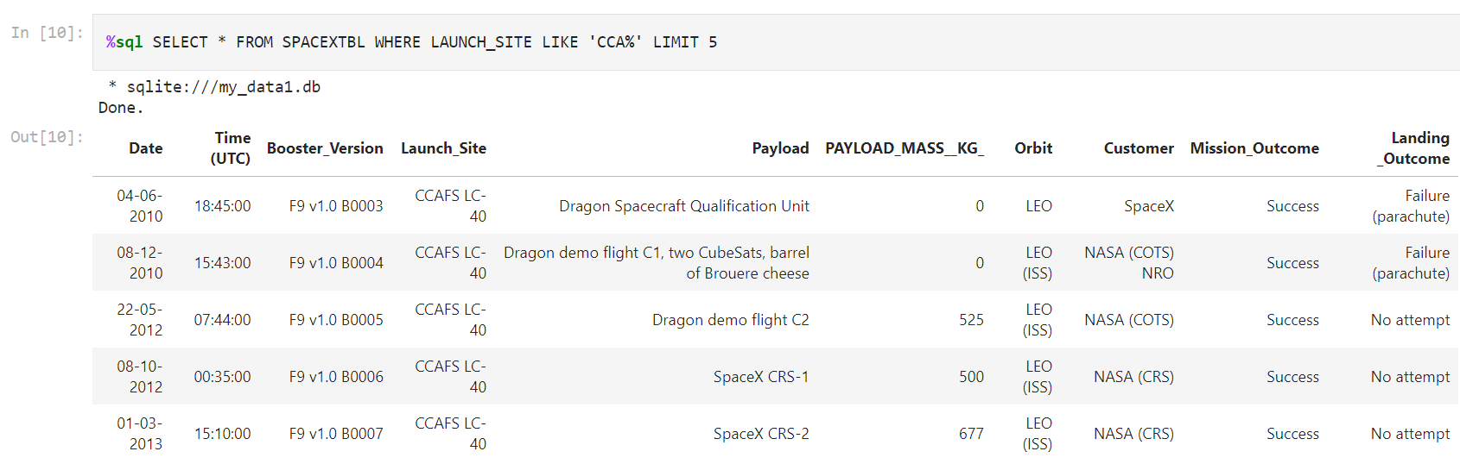
Launch Site Names Begin with 'CCA'
Find 5 records where launch sites begin with `CCA`
Using the * to select all from the SPACEXTBL we use condition where Launch_site is like ‘CCA%’ with the beginning and limit to 5 results

Slide 26
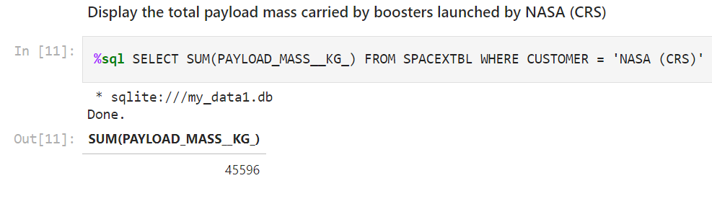
Total Payload Mass
Using SUM function of Paylod_Mass_Kg from SPACEXTBL we use condition where Customer = ‘NASA CRS’ to obtain the total payload mass carried by boosters launched by NASA (CRS)

Slide 27
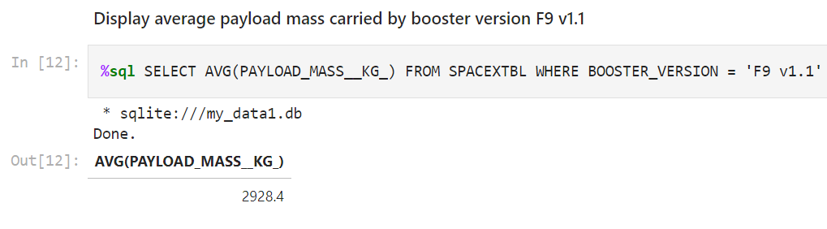
Average Payload Mass by F9 v1.1
Using the AVG function for Payload_Mass_Kg_ from the SPACEXTBL we use condition where Booster_version = ‘F9 v1.1’ to obtain the average payload mass carried by booster version F9 v1.1

Slide 28
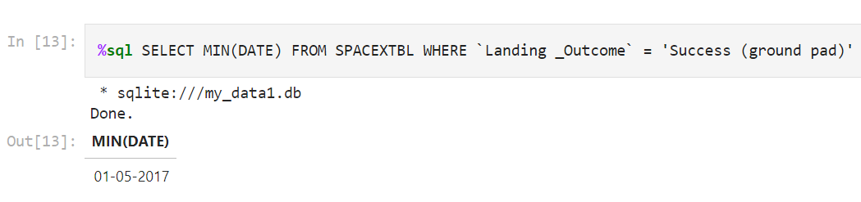
First Successful Ground Landing Date
Goal is to: Find the dates of the first successful landing outcome on ground pad
To do this using the Min function for Date from SPACEXTBL we use condition where ‘Landing_Outcome’ = ‘Success (ground_pad)’

Slide 29
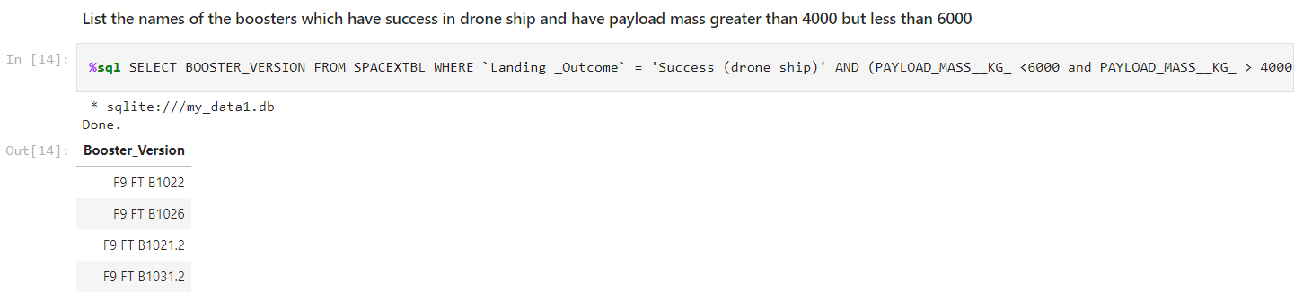
Successful Drone Ship Landing with Payload between 4000 and 6000
First we select Booster_version from SPACEXTBL and now list the conditions to be met
The conditions are ‘Landing_Outcome’ = ‘Success (drone ship)’ and (PAYLOAD_MASS__KG_ <6000 and PAYLOAD_MASS__KG_ > 4000)

Slide 30
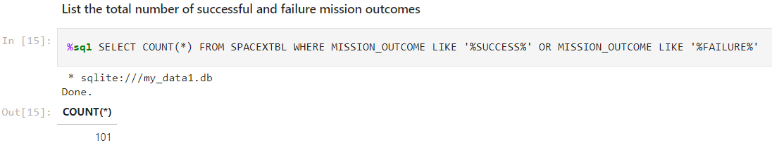
Total Number of Successful and Failure Mission Outcomes
Using Count function for the SPACEXTBL we then use where clause to meet the condition of ‘%Success%’ or ‘%Failure%’ for Mission_Outcome using wild card %

Slide 31
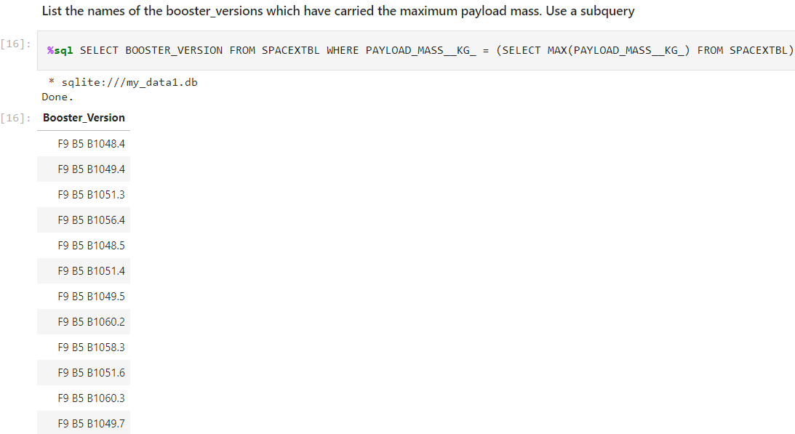
Boosters Carried Maximum Payload
Using column Booster_version we use the SpaceXTBL and use the where clause to find the max payload mass with use of subqueries

Slide 32
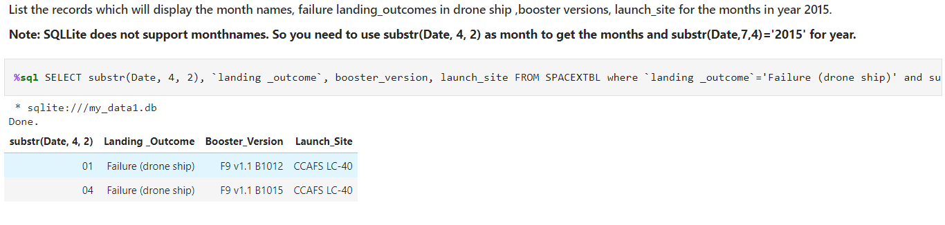
2015 Launch Records
With substr function and column names it is easy to select the columns we want
Next, we list the outcomes to find the time we can to use with failures associated

Slide 33
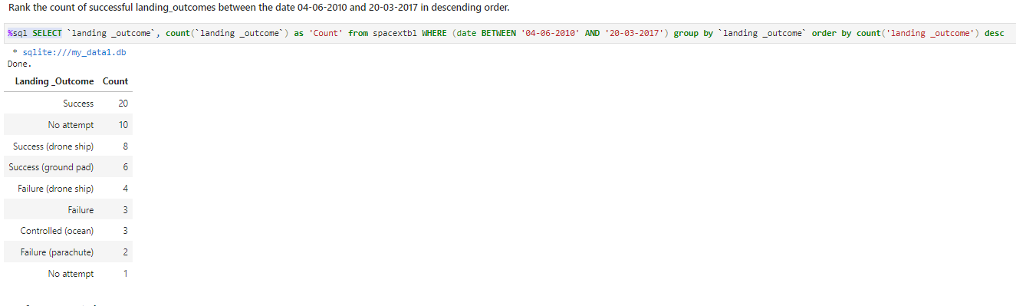
Rank Landing Outcomes Between 2010-06-04 and 2017-03-20
Using Group by on landing outcome column allows for aggregation function count to function properly which is followed with a condition to choose dates between 2010-06-04 and 2017-03-20 in descending order
Present your query result with a short explanation here

Slide 34

Section 3

Slide 35
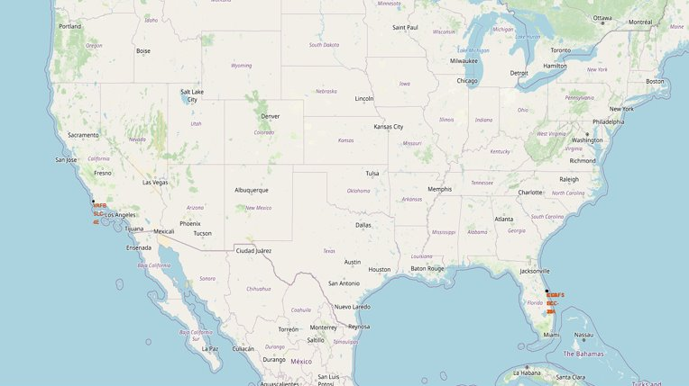
Launch Sites Analysis with Folium-Continued
Mark all launch sites on a map
Display the different launch sites with their labels
Allows us to notice any patterns in success rates based on locations

Slide 36
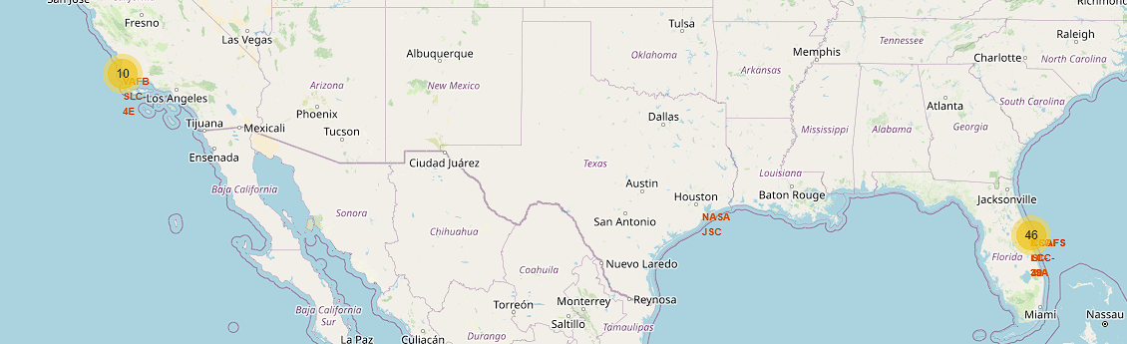
All launch sites success/failed
Mark the success/failed launches for each site on the map
Using Folium, we can see the different site launch locations in the United States and further dive into how their location of launch can impact on the success rate of each launch
When zooming in on the highlighted marks on the map it will display green icons for successful launches or red for failed launches at a given site

Slide 37
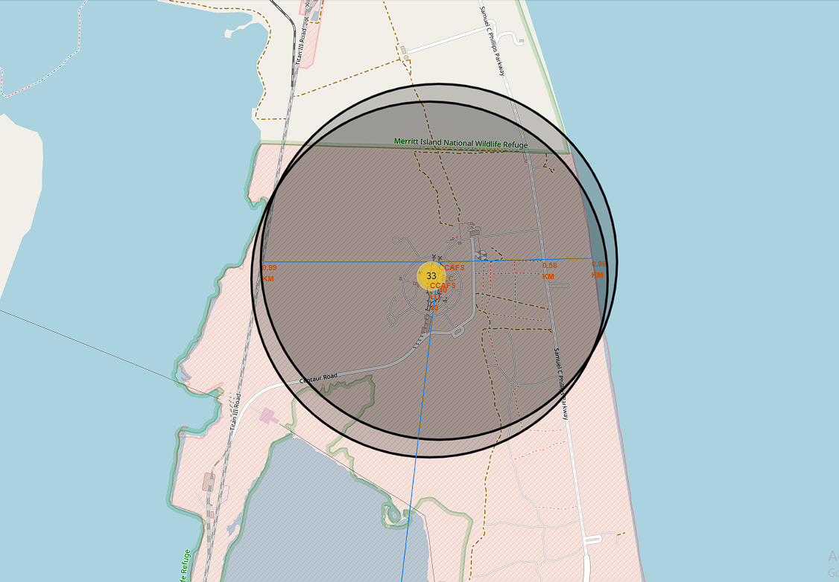
Launch Sites Distances to Proximites
Calculate the distances between a launch site to its proximities
Using functions to calculate the distances from railways, highways, and cities gives us references to the location at which the launch takes place

Slide 38

Section 4

Slide 39
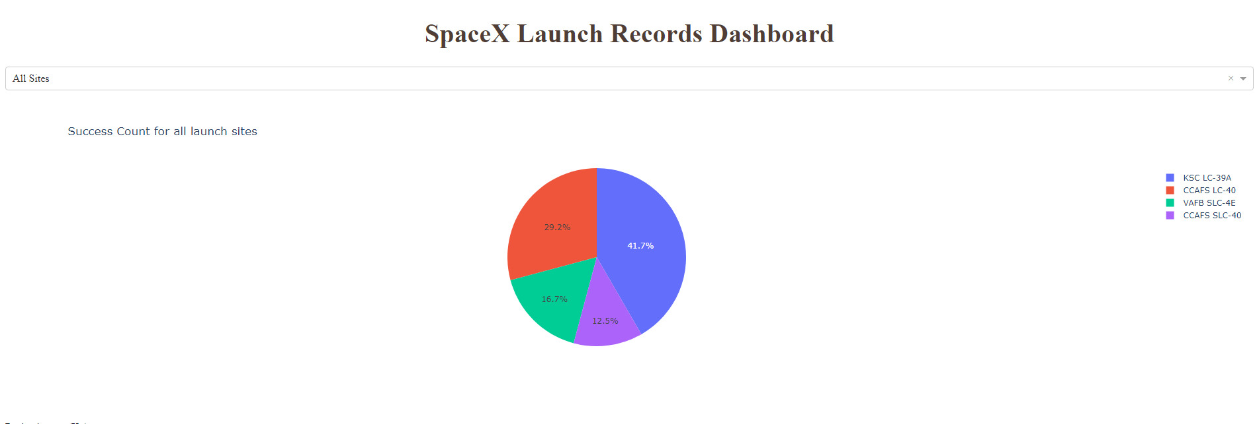
SpaceX Launch Records of All Sites Dashboard
Below is a screenshot of the pie chart using Plotly Dash
This pie chart represents the success rates of all sites where we can see that KSC LC-39A launch site had the highest success rate

Slide 40
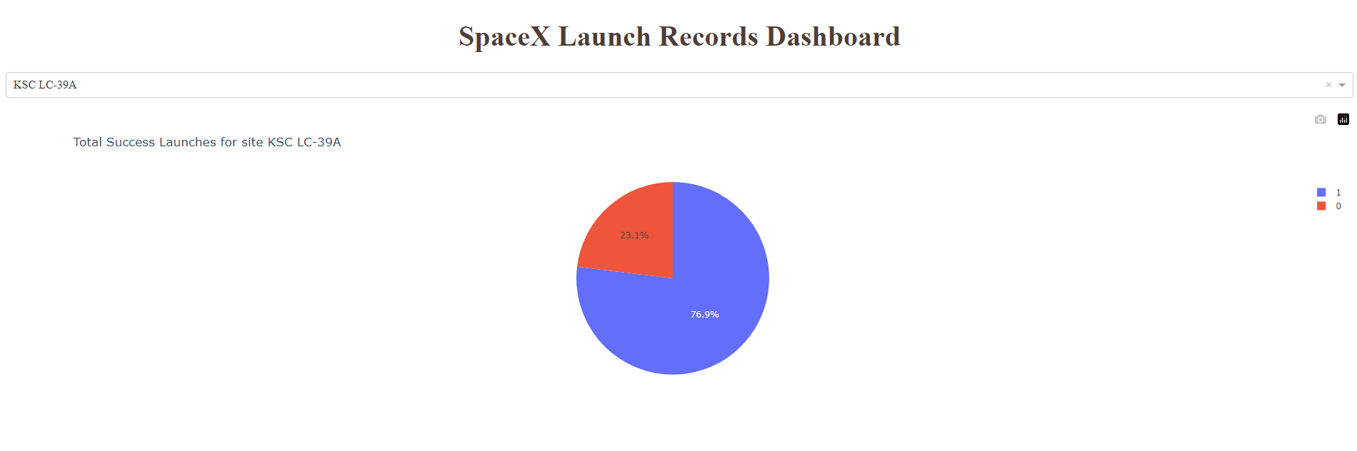
SpaceX Launch Records of Highest Launch Success Ratio
In the below pie chart KSC LC-39A has the highest launch success ratio
The legend on the right of the pie chart indicates 0 as failed launch and 1 as successful launch

Slide 41
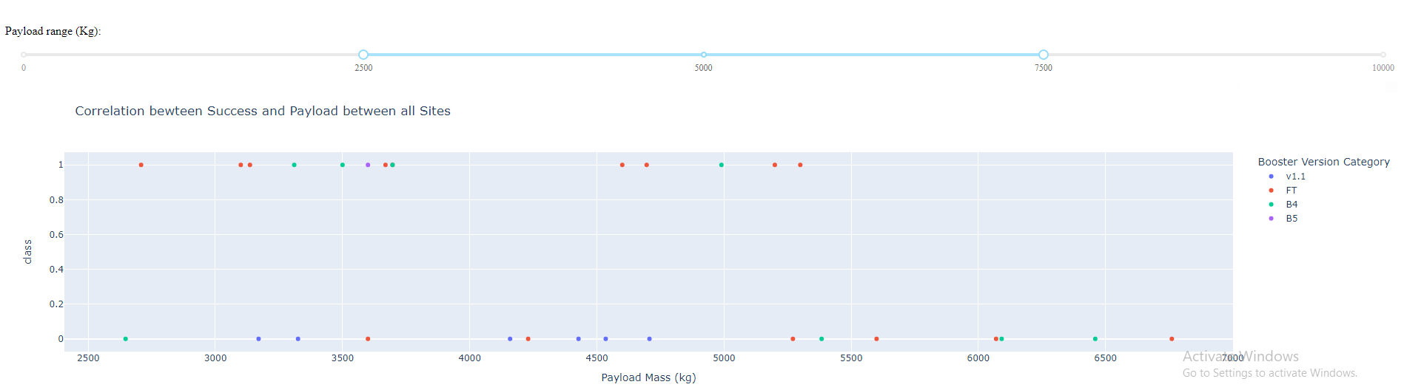
Payload vs. Launch Outcome Scatter Plot for All Sites
Using a different payload range from 2500 – 7500 we can see that FT booster version category is more successful than any other booster version
This as well as the v1.1 booster fails in with a success rate of 0

Slide 42

Section 5

Slide 43
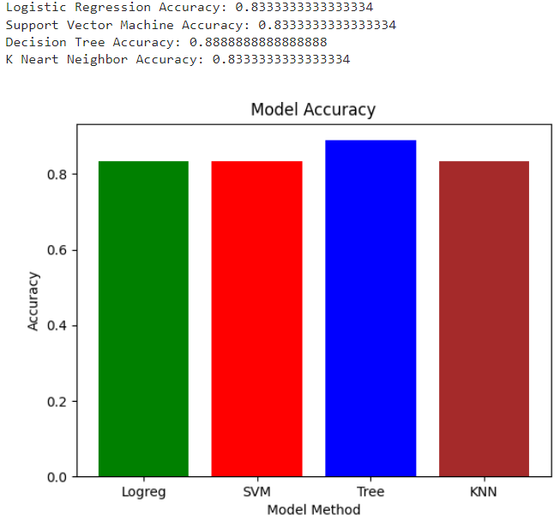
Classification Accuracy
Using all the different model methods they all generally had the same accuracy
Running the program multiple times, the Decision Tree modeling method slightly did better than the other modeling methods in terms of accuracy

Slide 44
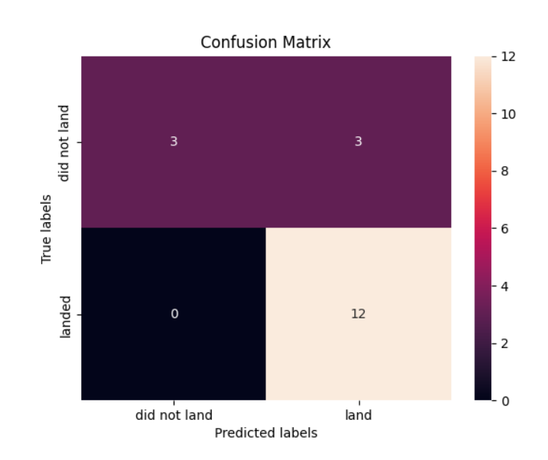
Confusion Matrix – Decision Tree
To the right there is a confusion matrix to the decision tree method
Looking at the confusion matrix it is clear that the predicted outcome labels were for the most part most like that of the actual labels

Slide 45
Conclusions
Our goal was to first be able to answer questions that would allow us predicted and save money on launches given the SpaceX Flacon 9 Launche information we received
Firstly, we began by using SpaceX API, Web Scraping knowledge, and Data wrangling to read accurate information for our use
Next, we utilized knowledge of SQL to return queries that would reveal important information that would be graphed for visualization purposes
After having everything we needed it finally possible to create predictive models, interactive visualization models, and folium maps to view all the data that was formatted/cleaned previously

Slide 46
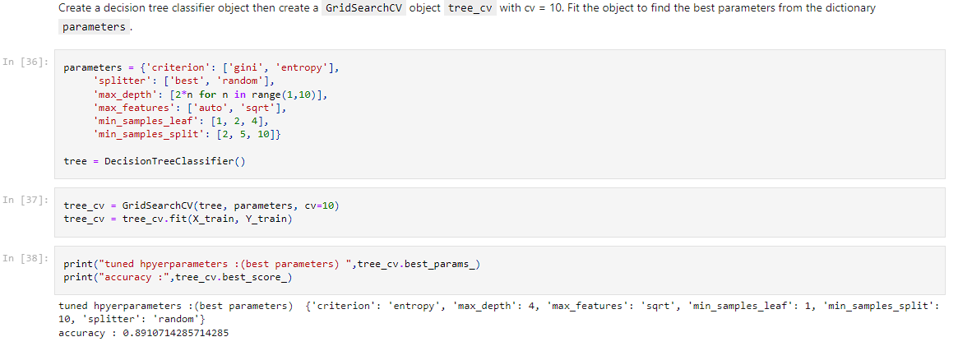
Appendix
The code below demonstrates the process to find the most accurate predictive model

Slide 47


